Slide 1


Introduction to Machine Learning Workshop
Filipe Barata, Konstantin Hopf
Bamberg | 20. September 2017

Slide 2
Agenda
Part A (13:15 – 14:45)
Intro/basics/general input for machine learning (30 min, Filipe)
Walk-through R code (30 min, Konstantin)
Hands on: load data, feature extraction, classification (30 min)
Part B (15:15 – 16:45)
Short intro: feature extraction from trading data (5-10 min, Filipe)
Hands on: feature development (20 min)
Technical input: classification algorithms and parameter (30 min, Konstantin)
Hands on: tune model (20 min)
Wrap-up: comparison of model performances, feedback (10 min)

Slide 3
Machine Learning 101
What is Machine Learning?
Statistical Inference: Two Cultures
Objects and Measurements
Goal of Learning
Empirical Risk
Bias vs Variance
Evaluation
Literature

Slide 4
Big data is like teenage sex: everyone talks about it, nobody really knows how to do it, everyone thinks everyone else is doing it, so everyone claims they are doing it...
Dan Ariely

Slide 5

What is Machine Learning?
Roach, Jay, Mike Myers, and Elizabeth Hurley. "Austin powers: International man of mystery." United States: New Line Cinema (1997).

Slide 6
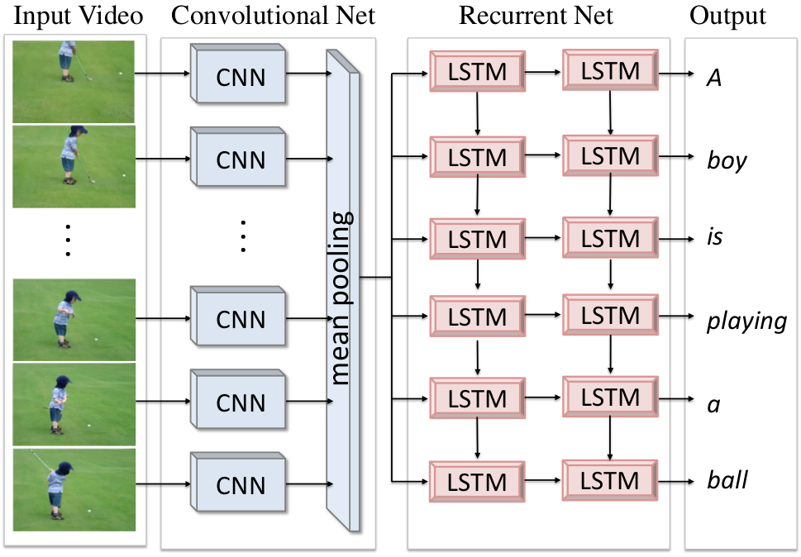
What is Machine Learning?
Venugopalan, Subhashini, et al. "Translating videos to natural language using deep recurrent neural networks." arXiv preprint arXiv:1412.4729 (2014).

Slide 7




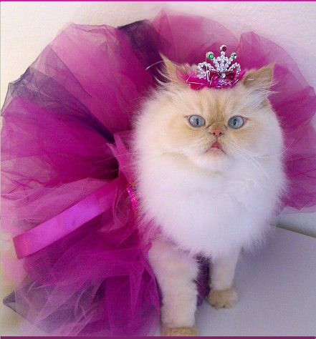

What is Machine Learning?
→
ƒ
LEARNING
ƒ( )
$$=$$
“CAT”
PREDICTION

Slide 8
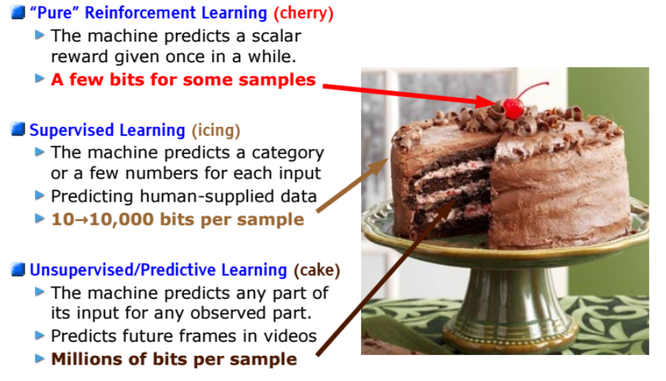
What is Machine Learning?
Yann LeCun : The Next Frontier in AI:
Unsupervised Learning
Yann, Lecun, “Deep Learning and the Future of AI." Talk, SoftBank Robotics Europe.

Slide 9
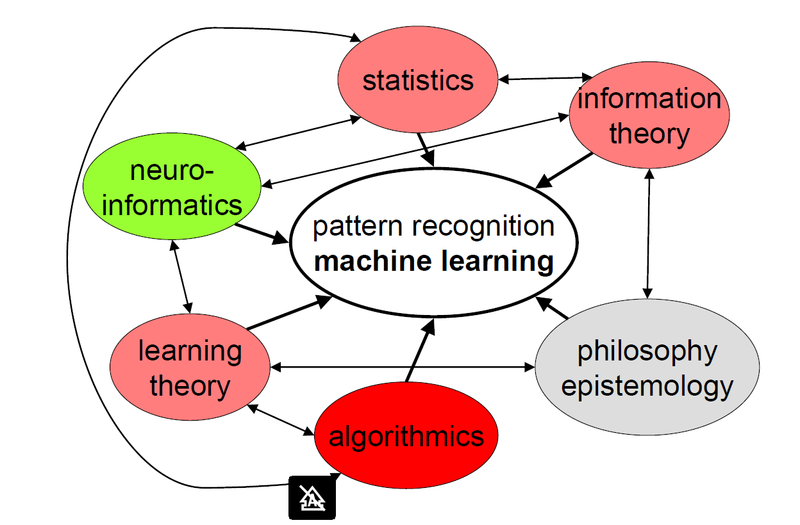
How Does “Machine Learning” Relate to Neighboring Scientific Areas
Buhmann, Joachim, “Machine Learning." ETH Zurich. 2016. Lecture

Slide 10

And There Shall Be Data…
Think of the data as being generated by a black box
There are two goals in analyzing the data:
Prediction
To be able to predict what the responses are going to be to future input variables
Information
To extract some information about how nature is associating the response variables to the input variables
Breiman, Leo. "Statistical modeling: The two cultures (with comments and a rejoinder by the author)." Statistical science 16.3 (2001): 199-231.

Slide 11
The Two Cultures
The Data Modeling Culture
The Algorithmic Modeling Culture
Assuming a stochastic data model
E.g. Data is generated by independet draws from Response variables = f(predictor variables, random noise, parameters)
Model Validation: Yes-no using goodness-of-fit tests and residual examination
Estimated Culture polulation: 98% of all statisticians
Inside box complex and unknown
Find function f(x) – an algorithm that operates on x to predict the response y
Model validation: Measured by predictive accuracy
Estimated culture population. 2% of statisticians, many in other fields
Breiman, Leo. "Statistical modeling: The two cultures (with comments and a rejoinder by the author)." Statistical science 16.3 (2001): 199-231.

Slide 12
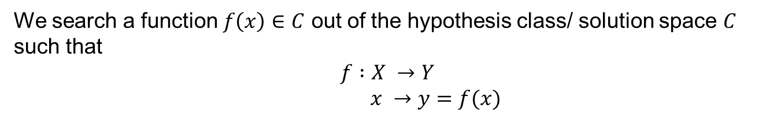
What is the learning goal?
We search a function $f\left(x\right)∈C$ out of the hypothesis class/ solution space $C$ such that
$$f :X →Y$$
$$x →y=f(x)$$
→
ƒ:
CAT

Slide 13
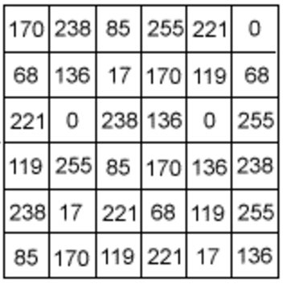

Objects and Measurements - Features
Measurements represent objects in a data space
e.g. cat pictures as objects and pixel intensity as measurements
$$\left(\begin{matrix}\begin{aligned}2 \\ 2\end{aligned} \\ 1\end{matrix}\right)$$
Typical:

Slide 14

Objects and Measurements
Real data often not $∈R^{d}$
Real data not well-behaved according to the machine learning algorithms
Features need to be engineered
A priori knowledge about the data may be helpful

Slide 15
Feature Space
Measurement space X: the mathematical space in which the data are represented, e.g., numerical, boolean or categorical features.
Features are derived quantities or indirect observations which often significantly compress the information content of measurements
Remark:
The selection of a specific feature space predetermines the metric to compare data; this choice is the first significant design decision in a machine learning system
Buhmann, Joachim, “Machine Learning." ETH Zurich. 2016. Lecture

Slide 16
The Goal of Learning
Estimation of Dependencies Based on Empirical Data
Typical learning problems:
Classification: Learning an indicator function
Regression: Learning a real valued function
Dimension reduction: Learning a linear or nonlinear
Data Compression: Learning a coding efficient representation
Vapnik, Vladimir Naumovich, and Samuel Kotz. Estimation of dependences based on empirical data. Vol. 40. New York: Springer-Verlag, 1982.

Slide 17
Classification: Learning an indicator function
Binary Classification

Slide 18
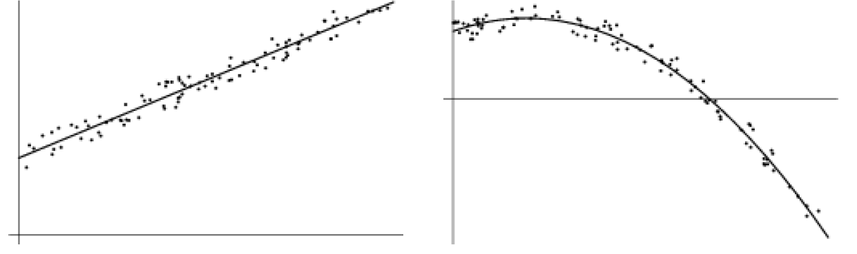
Regression: Learning a Real Valued Function
Linear Regression
Non- Linear Regression

Slide 19
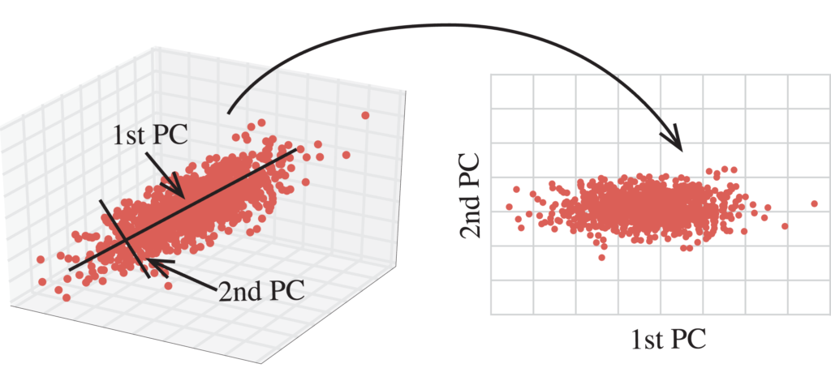
Dimension Reduction: Learning a Linear or Nonlinear Projection
Principal Component Analysis

Slide 20
Data Compression: Learning a Coding Efficient Representation
78 | 23
12 | 34
78 | 23
12 | 34

Slide 21
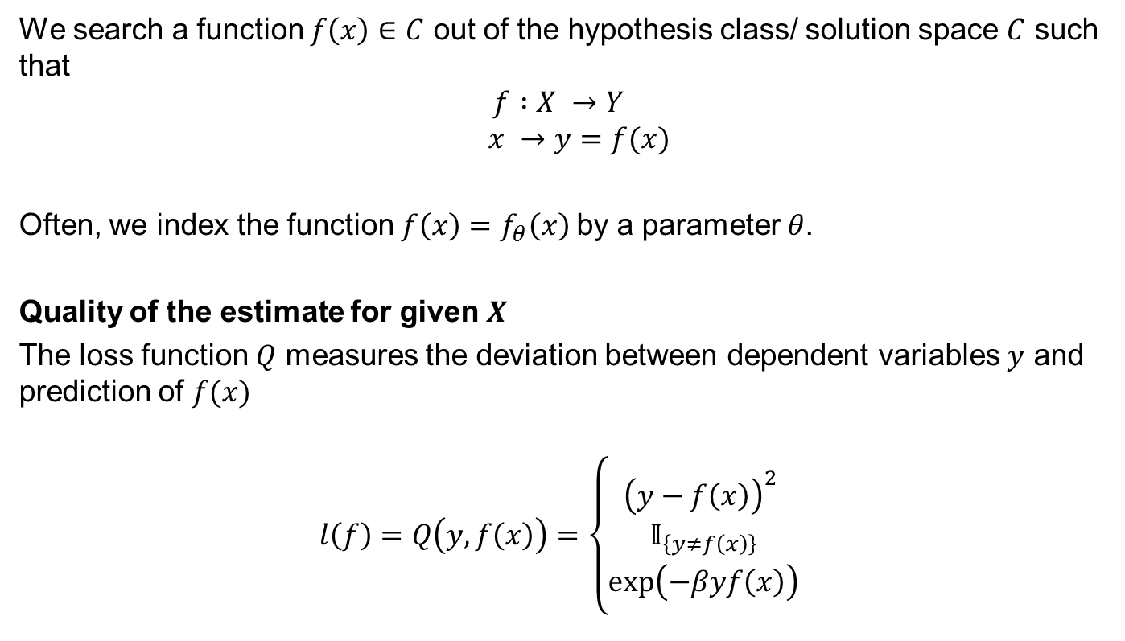
Estimating Dependencies Based on Empirical Data
We search a function $f\left(x\right)∈C$ out of the hypothesis class/ solution space $C$ such that
$$f :X →Y$$
$$x →y=f(x)$$
Often, we index the function $f\left(x\right)=f_{θ}\left(x\right)$by a parameter $θ$.
Quality of the estimate for given $X$
The loss function $Q$ measures the deviation between dependent variables $y$ and prediction of $f(x)$
$$l\left(f\right)=Q\left(y,f\left(x\right)\right)=\left\{\begin{aligned}{\left(y−f\left(x\right)\right)}^{2} \\ 𝕀_{\left\{y≠f\left(x\right)\right\}} \\ \exp\left(−βyf\left(x\right)\right)\end{aligned}\right.$$
Quadratic loss (regression)
0-1 loss (classification)
Exponential loss (classification)
Buhmann, Joachim, “Machine Learning." ETH Zurich. 2016. Lecture

Slide 22


Classifier evaluation
Confusion Matrices
Accuracy: “Correct decisions”
 | True positive | True negative
Predicted positive | TP | FP
Predicted negative | FN | TN
$$Accuracy= \frac{TP+TN}{TP+FN+FP+TN}$$
Precision: “Actual positives among positively tested”
 | True positive | True negative
Predicted positive | TP | FP
Predicted negative | FN | TN
$$Precision= \frac{TP}{TP+FP}$$
Recall: “Ability to detect positives”
 | True positive | True negative
Predicted positive | TP | FP
Predicted negative | FN | TN
$$Precision= \frac{TP}{TP+FN}$$

Slide 23
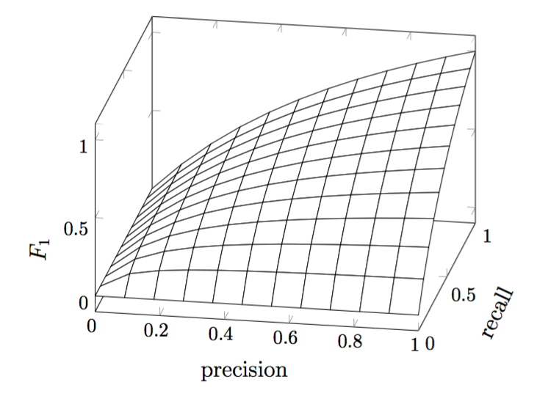
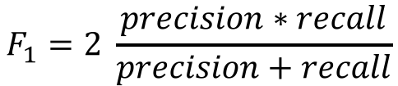
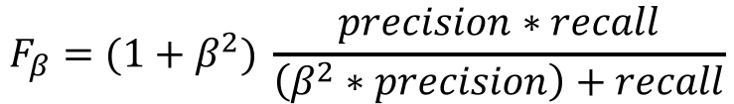
Trade-off between precision and recall
In classifier tuning, precision and recall needs to be optimized
Therefore, the harmonic mean between both measures F₁ is considered
F₁ has its best value at 1 and its worst at 0
To weight either precision or recall, the parameter β can be introduced:
$$F_{1}=2 \frac{precision∗recall}{precision+recall}$$
$$F_{β}=(1+β^{2}) \frac{precision∗recall}{\left(β^{2}∗precision\right)+recall}$$

Slide 24
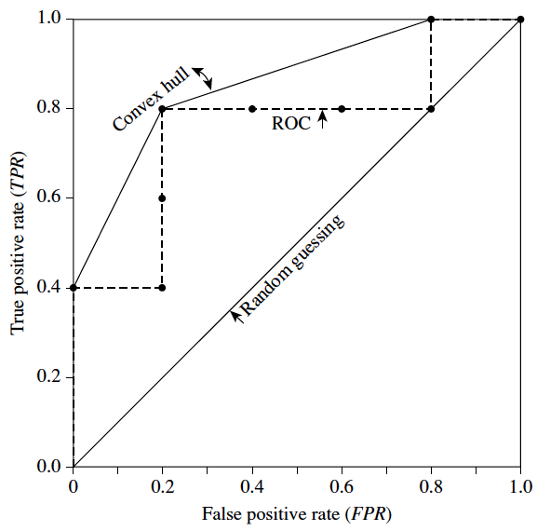
Recap: Receiver Operating Characteristics (ROC)
A further tool for classifier evaluation are ROC curves
ROC shows the trade-off between the
true positive rate (TPR=TP/P) and
false positive rate (FPR=FP/N).
The area under ROC curve (AUC) is a common metric for classifier evaluation.
Classification: ideally AUC > 0.5
Random guessing: AUC = 0.5

Slide 25
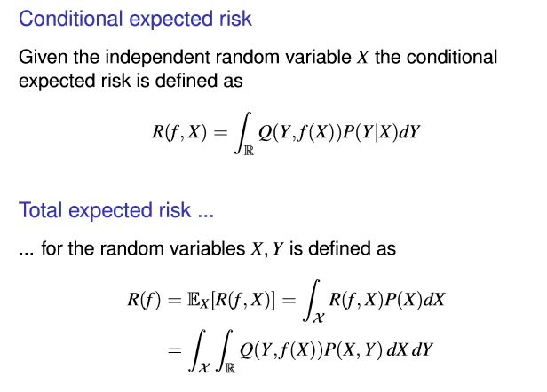
Expected risk
Buhmann, Joachim, “Machine Learning." ETH Zurich. 2016. Lecture

Slide 26
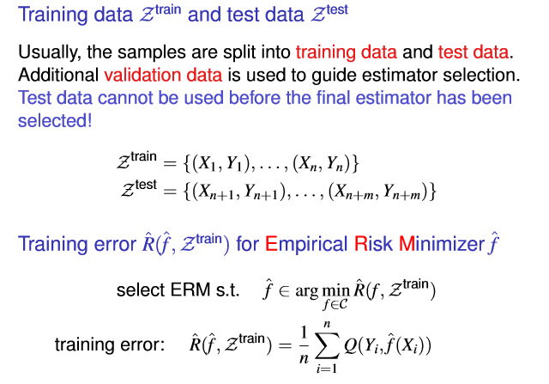
Empirical Risk
Buhmann, Joachim, “Machine Learning." ETH Zurich. 2016. Lecture

Slide 27
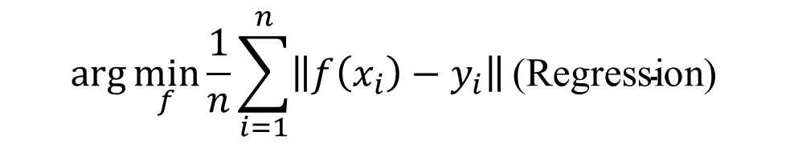
Remarks
Learning requires to infer a functional or statistical relationship between variables when we only know noisy samples. Approximation and interpolation in function estimation are such procedures.
The problem without additional assumptions is mathematically ill-deﬁned since many different functions might be compatible with noisy observations.
We, therefore, require that our inference has to “work” on future data. Mathematically, the expected quality of inference should be high and not necessarily the empirically observed quality.
$$\arg{\min_{f}{\frac{1}{n}}{\sum_{i=1}^{n}{\left\|f\left(x_{i}\right)−y_{i}\right\|}}{\text{(}\text{Regression}\text{) }}}$$
Existence
Convergence
Buhmann, Joachim, “Machine Learning." ETH Zurich. 2016. Lecture

Slide 28
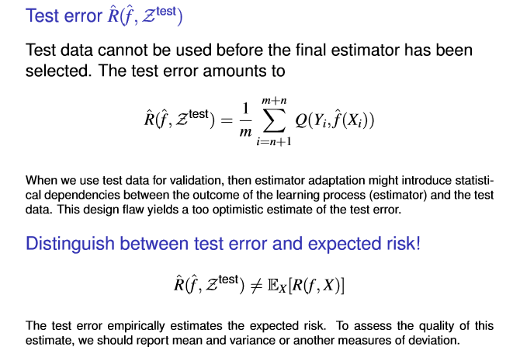
Empirical Test Error and Expected Risk
Buhmann, Joachim, “Machine Learning." ETH Zurich. 2016. Lecture

Slide 29
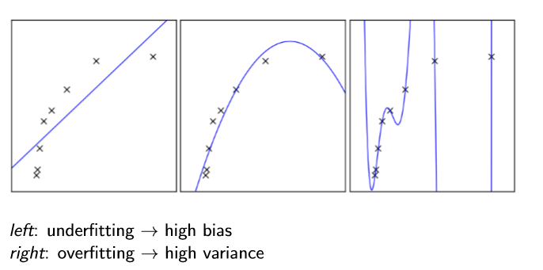






Data Dimensions
ng Dependencies Based on Empirical Data
Bias vs. Variance
% error
% error
test
$E_{∞}$
test
training
$$h=h^{∗}$$
$l_{c}$
capacity $(h)$
training set size $(l)$
Buhmann, Joachim, “Machine Learning." ETH Zurich. 2016. Lecture

Slide 30
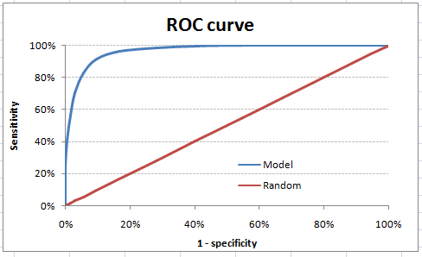

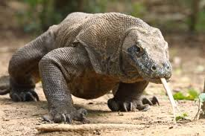
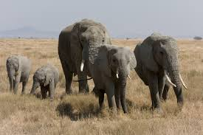
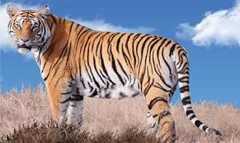













Learning Pipeline
Features Extraction
Training
Evaluation
«cat»
$$\left(\begin{matrix}\begin{aligned}2 \\ 2\end{aligned} \\ 1\end{matrix}\right)$$
$$\left(\begin{matrix}\begin{aligned}2 \\ 2\end{aligned} \\ 1\end{matrix}\right)$$
$$\left(\begin{matrix}\begin{aligned}2 \\ 2\end{aligned} \\ 1\end{matrix}\right)$$
$$\left(\begin{matrix}\begin{aligned}2 \\ 2\end{aligned} \\ 1\end{matrix}\right)$$
$$\left(\begin{matrix}\begin{aligned}2 \\ 2\end{aligned} \\ 1\end{matrix}\right)$$
$$\left(\begin{matrix}\begin{aligned}2 \\ 2\end{aligned} \\ 1\end{matrix}\right)$$
$$\left(\begin{matrix}\begin{aligned}2 \\ 2\end{aligned} \\ 1\end{matrix}\right)$$
$$\left(\begin{matrix}\begin{aligned}2 \\ 2\end{aligned} \\ 1\end{matrix}\right)$$
$$\left(\begin{matrix}\begin{aligned}2 \\ 2\end{aligned} \\ 1\end{matrix}\right)$$
«no cat»
$$\left(\begin{matrix}\begin{aligned}3 \\ 3\end{aligned} \\ 4\end{matrix}\right)$$
$$\left(\begin{matrix}\begin{aligned}3 \\ 3\end{aligned} \\ 4\end{matrix}\right)$$
$$\left(\begin{matrix}\begin{aligned}3 \\ 3\end{aligned} \\ 4\end{matrix}\right)$$
$$\left(\begin{matrix}\begin{aligned}3 \\ 3\end{aligned} \\ 4\end{matrix}\right)$$
$$\left(\begin{matrix}\begin{aligned}3 \\ 3\end{aligned} \\ 4\end{matrix}\right)$$
$$\left(\begin{matrix}\begin{aligned}3 \\ 3\end{aligned} \\ 4\end{matrix}\right)$$
$$\left(\begin{matrix}\begin{aligned}3 \\ 3\end{aligned} \\ 4\end{matrix}\right)$$
$$\left(\begin{matrix}\begin{aligned}3 \\ 3\end{aligned} \\ 4\end{matrix}\right)$$
$$\left(\begin{matrix}\begin{aligned}3 \\ 3\end{aligned} \\ 4\end{matrix}\right)$$
$$\left(\begin{matrix}\begin{aligned}3 \\ 3\end{aligned} \\ 4\end{matrix}\right)$$
$$\left(\begin{matrix}\begin{aligned}3 \\ 3\end{aligned} \\ 4\end{matrix}\right)$$
$$\left(\begin{matrix}\begin{aligned}3 \\ 3\end{aligned} \\ 4\end{matrix}\right)$$
Sensitivity | Specificity | Accuracy
92 % | 83 % | 88 %
$$\left(\begin{matrix}\begin{aligned}3 \\ 3\end{aligned} \\ 4\end{matrix}\right)$$
$$\left(\begin{matrix}\begin{aligned}3 \\ 3\end{aligned} \\ 4\end{matrix}\right)$$
$$\left(\begin{matrix}\begin{aligned}3 \\ 3\end{aligned} \\ 4\end{matrix}\right)$$
Data
Features
Model
Results

Slide 31
Evaluation
Evaluation Dependencies Based on Empirical Data
BIG
Train
Validation
Test
Randomly split your dataset into a training set, a validation set and a test set.
Due to the large size of the validation and the test set, the estimation of the generalization error is accurate enough to be used for model selection and model assessment
DATA
Train & Validation & Test
SMALL
May not be able to aﬀord sacriﬁcing a large fraction of the available data for validation and testing.
Instead, one can use cross-validation or bootstrapping.
Buhmann, Joachim, “Machine Learning." ETH Zurich. 2016. Lecture

Slide 32
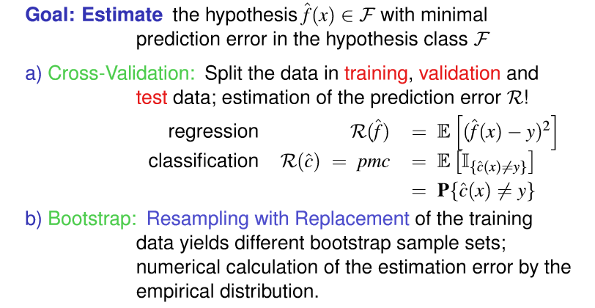
Numerical Estimation Techniques
Buhmann, Joachim, “Machine Learning." ETH Zurich. 2016. Lecture

Slide 33
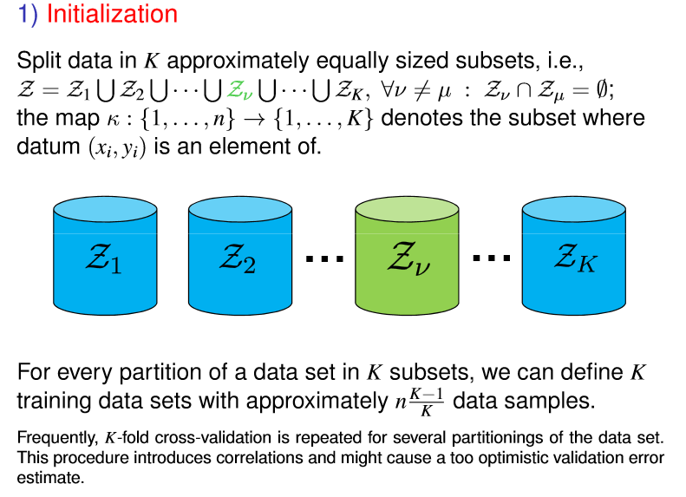

$K$-Fold Cross-Validation
Buhmann, Joachim, “Machine Learning." ETH Zurich. 2016. Lecture

Slide 34
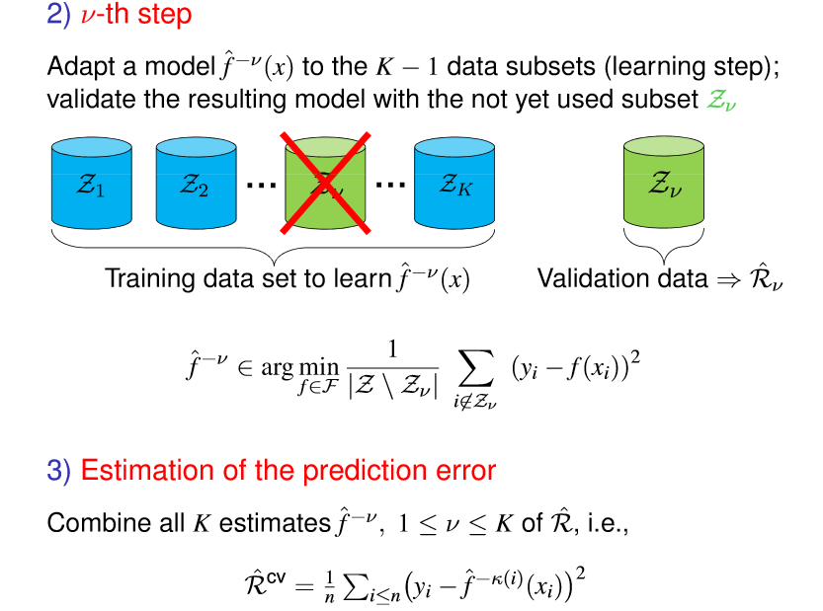
Buhmann, Joachim, “Machine Learning." ETH Zurich. 2016. Lecture

Slide 35
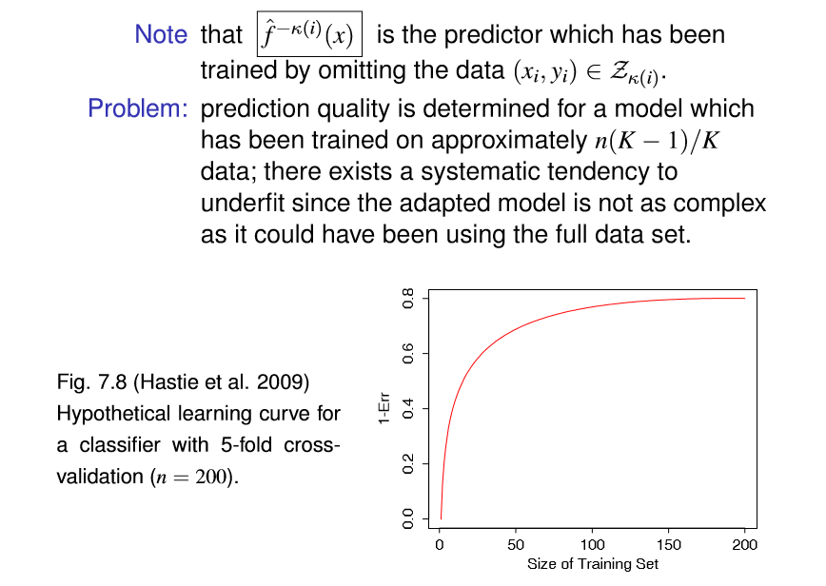
$K$-Fold Cross-Validation
Buhmann, Joachim, “Machine Learning." ETH Zurich. 2016. Lecture

Slide 36
Literature
Bishop, Christopher M. Pattern recognition and machine learning. springer, 2006.
Duda, Richard O., Peter E. Hart, and David G. Stork. Pattern classification. John Wiley & Sons, 2012.
Friedman, Jerome, Trevor Hastie, and Robert Tibshirani. The elements of statistical learning. Vol. 1. New York: Springer series in statistics, 2001.

